Slide 1


Cloud as Coach “How Cloud Technology Can Reverse the Widening Talent Gap”
Alan Dowzall
ad@Kessaku.com
www.Kessaku.com
@Dowzall

Slide 2


What We Want to Share With You
Cloud as Coach
Your Questions?
Industry Insights into Widening Talent Gaps
Business Opportunities of Making All of Your People as Good as Your Best
Microsoft’s Cloud as Coach Case Study
How New Cloud as Coach Technologies are Closing Talent Gaps

Slide 3
You Face Many Challenges Daily
Recruitment
Retention
Attracting The Best Talent
Inconsistent Feedback & Manger Coaching
Modernization of 360 Assessments
Best Financial Incentives
Talent Shortages
Lack of Development Planning
One size fits all Training
On Boarding & accelerating time to impact
Influence of recent Performance
Discontent with Performance Reviews
Retaining Your Best Talent

Slide 4
You Face Many Challenges Daily
Recruitment
Retention
Attracting The Best Talent
Inconsistent Feedback & Manger Coaching
Modernization of 360 Assessments
Best Financial Incentives
Talent Shortages
Lack of Development Planning
One size fits all Training
On Boarding & accelerating time to value
Influence of recent Performance
Discontent with Performance Reviews
Retaining Your Best Talent

Slide 5
The Widening Talent Gap
Through the lens of the Corporate Executive Board, Authors of The Challenger Sale
In transactional selling environments the performance gap between average and Star Performers is 59%
In Complex Solution Selling Environments the performance gap between average and Star Performers is 200%
“Of One Hundred Sales Reps, 2 were responsible for 80% of revenues” Business Services Co.
Dramatic rise in Key-Person Dependency problems

Slide 6
Poll
Do you know if you have a Talent Gap?
Do you Know How big the Talent Gap is?
Do you know the Impact of reducing the Gap?

Slide 7
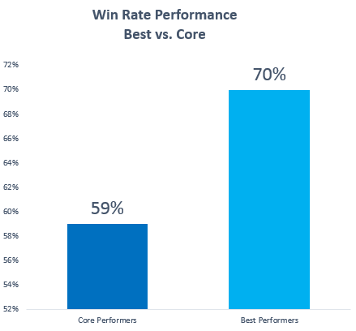
Impact of Closing the Talent Gap
Q4
FY14
5 Years
11%
Improving Win Rates represented a $19m Opportunity
Improving Win Rates
represented a
$75m Opportunity
Improving Win Rates
represented a
*$458m Opportunity
*Assume CAGR of 10%
Division of Software Company
Based on comparing Win Rate data blended for 2013/14
Data is for example purposes only.

Slide 8
The Pain Chain
Global Economic Downturn
Manager
Coaching
Dropping Down
the Priority List
Managers
as Referees
Shouting
“offside”
Manpower describes the new environment as the “Human Age” in which finding and keeping the right talent is a critical strategic priority.
---2013 Manpower Survey
New Business Environment
Workers want
more
Continuous & Timely
Feedback
Managers Focused on Closing Deals
Reduction in Budgets
Discontent
with Review
& 360
Processes
Consensus Based Buying
Widening Talent Gap
Information Parity, Buyers know Everything
Core Performers falling behind
the Best

Slide 9

Impacting Core Performers
Recognition
Challenge
Purpose
(Contribute to
something meaningful)
Factors that Drive Core Performer Success…
Core Performers are Looking For…
Challenge – Something that has purpose, is meaningful and desirable
Feedback – The need for continuous feedback to identify ways to improve
Learning – Learning from others and self- directing own roadmap towards Mastery
Recognition – Joy that comes from Recognition from Peers
A New Coaching Paradigm
Motivation
(From the Power of Recognition)
Autonomy
(Desire to be self-directed)
Paradigm Embedded into New Cloud as Coach Technologies
Learning
Feedback
Mastery
(Joy that comes from getting better)
Based on “The Intrinsic Factors that Drive People”— Dan Pink, Author of Drive & To Sell is Human.

Slide 10
Poll
Do you know the factors that drive Core Performer Success?
Do you have a Plan to focus on the factors?
Are You using Cloud Technologies to help You?

Slide 11

Cloud as Coach
Technology that impacts the factors that Drive Core Performers…
Recognition…
Recognize great work with Medals & Badges
Send messages of Appreciation
Share with team through Social Integration
Challenge…
Profile of Excellence
North Star for reaching highest performance levels
Focused on “My Role”
Based on what Best Performers do differently
Medals & Badges
Profiles of Excellence
Learning…
Development Roadmap
Links to Training
Connects with Best Performers
Sets, Tracks & Shares Goals (Auto)
Feedback…
Network of Feedbackers
Self-Administered
Captures Standing relative to Peers
Cloud as Coach
Feedback Network
“Drivers for Core Performance”
Development Roadmap

Slide 12

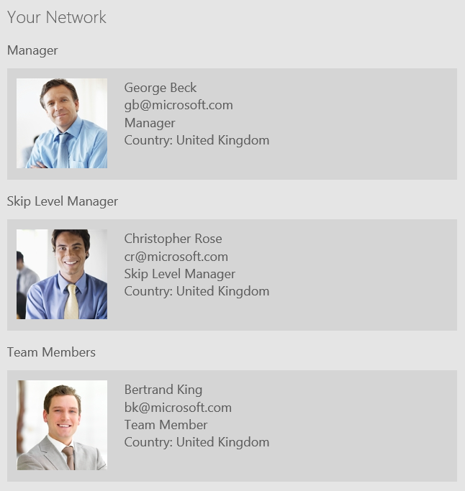
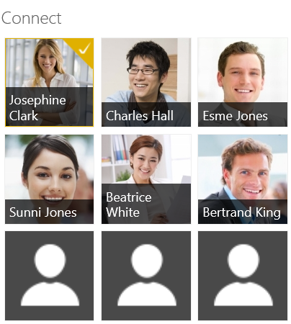
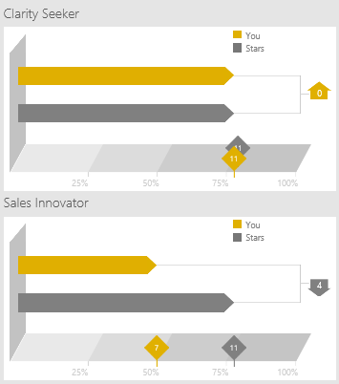

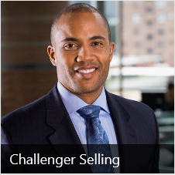

Microsoft Cloud as Coach Solution
Success Factors for Microsoft…
Profiles of Excellence align Sales, Marketing, Partner & Leadership Roles
Based on highest levels of Excellence
Self-Administered Feedback Network
Managers, Skip Level Managers, Team Members. Customers & Partners
Connect with Best Performers
Connections based on Priority Areas for Improvement
Everyone Knows where they stand vs. highest levels
Reports show Development Priorities compared with Best Performers
Profiles of Excellence
Feedback
Connect
Development

Slide 13

Profiles of Excellence
Profiles of Excellence are the Centre of Gravity for Cloud as Coach…
Practices
Excellence Indicators
Partner Manager
Profile
of Excellence
A
Develops a compelling strategic vision; Partner Building Plan as a way to set goals/align with the product and Industry forecasts and local market opportunity
Seeks input from multiple sources including corporate and cross-segment stakeholders often assessing multiple scenarios before honing in on the chosen strategy
Able to express oneself clearly in ways that inspire others to follow and make sharp statements about the future with an enthusiasm that attracts others
Has the in-built maker instinct, a drive to develop new Partners and ways to deliver value. Likes to see "BOLD" ideas develop, understand relationships and influence what happens
Clarity Seeker
Builds Strategic Vision
Collaborates with multiple sources
Expresses oneself in ways that inspire
Finds Bold ways to deliver value
Breaks down the Challenge
B
Challenges the assumptions of the partner and re-frames their world in ways they haven't thought or appreciated before…unlocks the key to dilemmas facing partners
Able to ask powerful questions resulting from knowledge gained from immersing oneself in the dilemma and with the people who are most impacted
Expert at connecting new insights about partner business opportunities linked back to the capabilities that only the Company can offer…implies deep expertise of “The Company“
Builds strong consensus across Partners tailoring messaging to different stakeholders to achieve maximum resonance and influence board room level decision making
Dilemma Flipper
Challenges Partner Assumptions
Asks Powerful Questions
Connects Insights to The Company
Builds Strong Consensus
“Indicators of Excellence are developed based on decoding what the
Best Performers do differently to everyone else.”

Slide 14
Lessons Learnt
Lessons Learnt through the Deployment of Cloud as Coach at Microsoft…
Normalizing Data
Feedback always has the possibility of inherent Bias
Ways to Normalize:
Train Managers on how to give feedback
Compare Manager vs. Self Feedback and follow-up on gaps
2 Feedbackers is good, 3 is best
Compare Data Metrics to help surface feedback issues
Encouraging Feedback
Data is only as good as the quality of feedback
Ways to make sure the Quality & Frequency is good:
Make it Self-Administered
Reward Feedback
Build Dashboards
Avoid Annual Cycles
Encourage regular feedback cycles weekly with 2-3-5 questions
Always Give back something meaningful in return
Action Planning
Separate Performance Conversations from Development Conversations
Deliver personalized Development roadmaps
Link Development Priorities to Readiness Curriculum
Provide Concierge to help understand results and make recommendations
Goal Setting
Establish Community Goals
Rally Frontline Managers and Community around Gap to Goals
Reward progress for reaching Goals
Develop personal badges and awards from Key Stakeholders
Publicize Key Stakeholders giving awards
Link into main conversation feed such as Yammer

Slide 15
Your Questions
Cloud as Coach
Your Questions?
Industry Insights into Widening Talent Gaps
Business Opportunities of Making All of Your People as Good as Your Best
Microsoft’s Cloud as Coach Case Study
How New Cloud as Coach Technologies are Closing Talent Gaps

Slide 16
Cloud as Coach “How Cloud Technology Can Reverse the Widening Talent Gap”
Alan Dowzall
ad@Kessaku.com
www.Kessaku.com
@Dowzall

